Slide 1

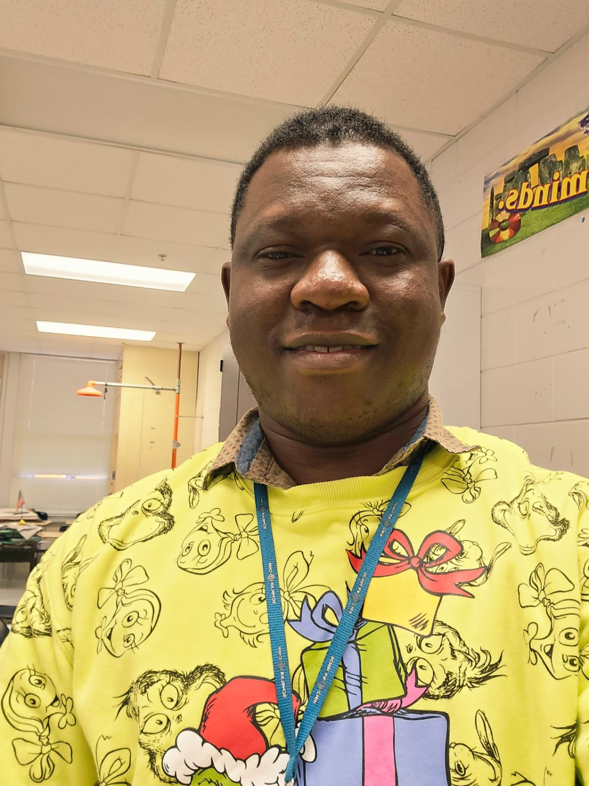
My name is David Kwame Darkwah from Ghana. Fourth born among six siblings - five brothers and a sister. Married with a daughter. Hold a Bachelor's degree in Integrated Science Education. Have 13 years of teaching experience; 10 years in Ghana and 3 years in the US. I'm a Christian. I love listening to music though I'm not a good singer. I love soccer and a big fan of Cristiano Ronaldo.
Mr. D. Darkwah
13 years in teaching
I love soccer and a big fan of Cristiano Ronaldo.

